Slide 1
Pre Calculus 12H
Ch2 Transformation REVIEW

Slide 2
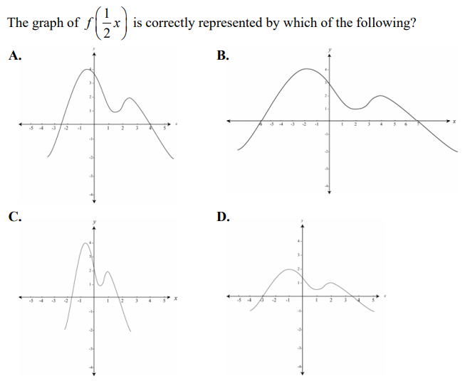
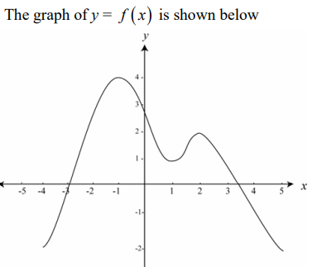

Slide 3
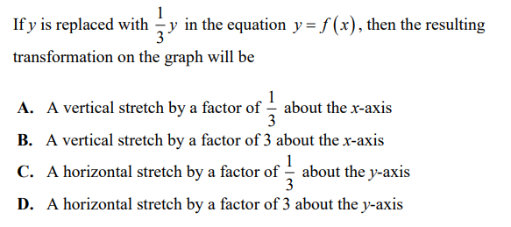

Slide 4
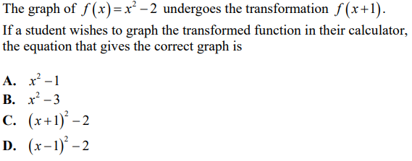

Slide 5
How many of the following functions will stay the same after a reflection
over the y-axis?
Only 1
Two Functions
Three Functions
Four Functions
ALL of THEM
None of them

Slide 6
The following function is Horizontally shifted 6 units LEFT. Which of the equations is the resulting function?

Slide 7


Slide 8


Slide 9
The function below is shifted 1 unit left, then HE by 2, then HS 2 left, and then HE by 3. Which of the following is the resulting function?

Slide 10
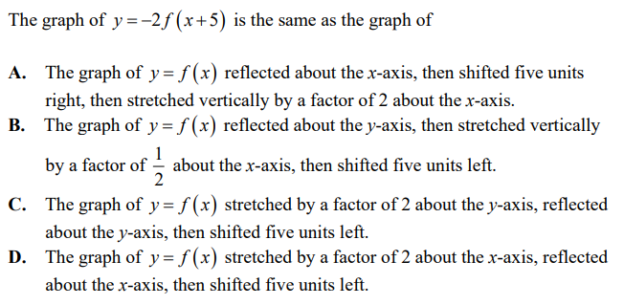

Slide 11
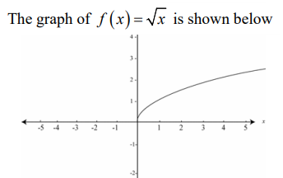
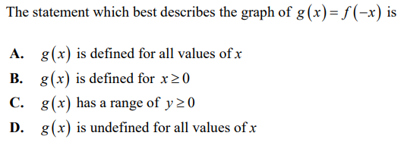

Slide 12
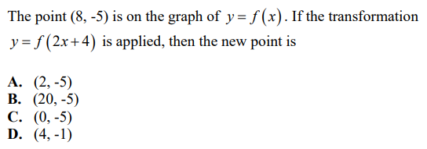

Slide 13
The following function will all undergo a horizontal expansion by a factor of 2. Which of the following is the correct equation after the transformation?

Slide 14
The following function will all undergo a horizontal expansion by a factor of 3. Which of the following is the correct equation after the transformation?

Slide 15


Slide 16


Slide 17


Slide 18
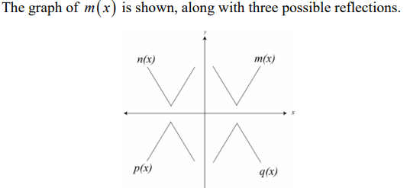

Which equation is n(x), p(x) , and q(x)??

Slide 19
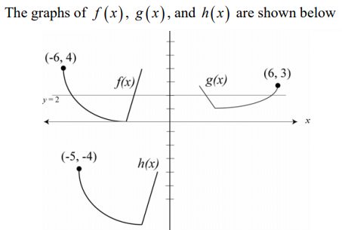
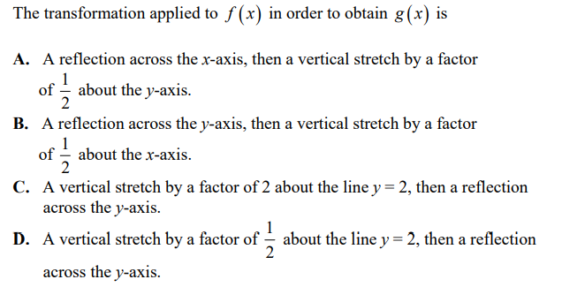

Slide 20
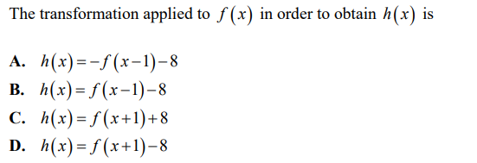

Slide 21
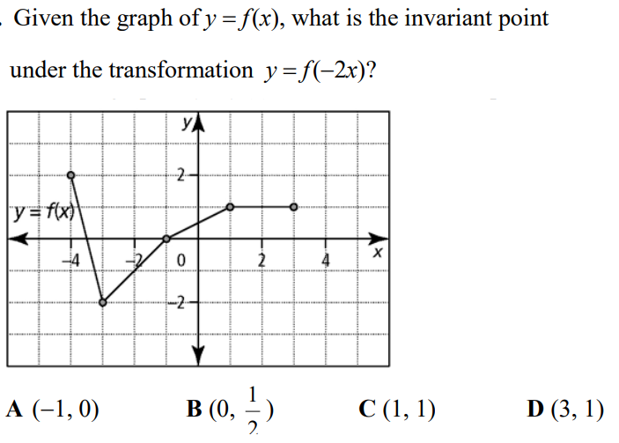

Slide 22
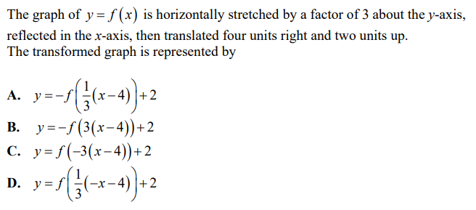

Slide 23


Slide 24
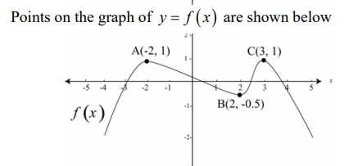


Slide 25


Slide 26


Slide 27
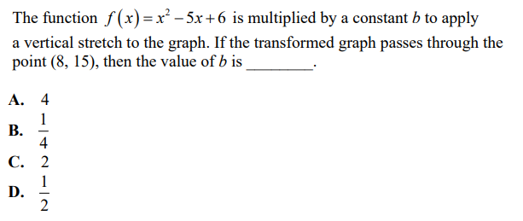

Slide 29
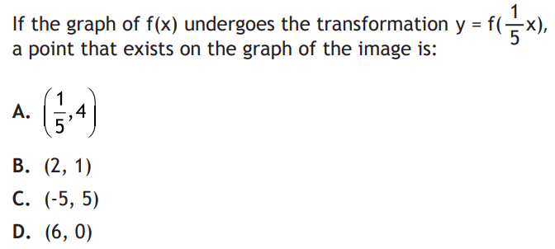
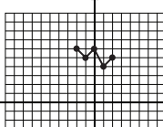

Slide 30
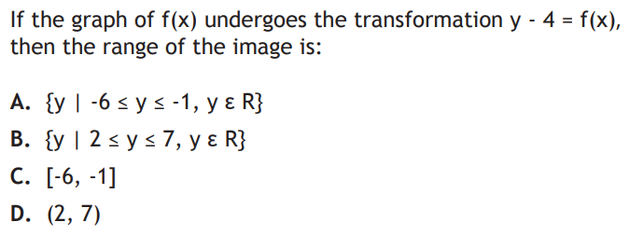


Slide 32
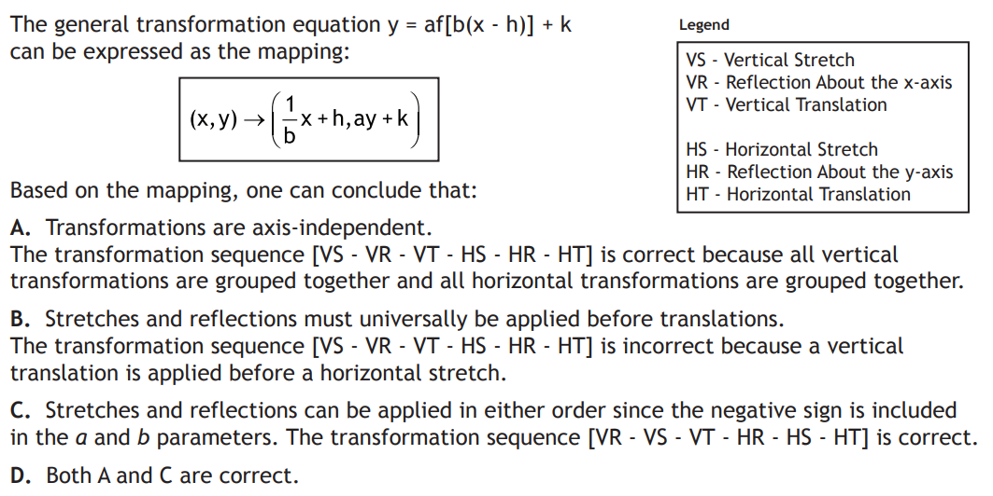

Slide 33


Slide 34


Slide 36


Slide 37


Slide 38
